Slide 1
Image Corpus Representative Summarization
Anurag Singh*, Lakshay Virmani*, and A.V Subramanyam
NSUT DELHI*, IIIT DELHI, INDIA

Slide 2

Outline
Motivation
Problem Overview
Challenges
Proposed Method
Experimental Results
Conclusion
Future Work Areas
References

Slide 3
Motivations
Summarization is an essential requirement for:
Efficient Representation
Navigation
Exploration
Notes:
Web image collection for e-commerce, tourism and travel exploration, story-telling from personal album collections, online image recommendation systems are some of the immediate applications of automatic image corpus summarization.

Slide 4
Motivations
While training machine learning algorithms
Deep networks require significant amount of time even for fine-tuning
Summary can be used for rapid prototyping of models.
Annotated summary is not readily available.
Train models without trading-off much on accuracy as the diversity of data is maintained while saving huge computational resources.
Notes:
large datasets it is tedious and costly to summarize. High quality and confidence will be needed in annotations to avoid bias and fairness issues resulting from skewed representations.

Slide 5
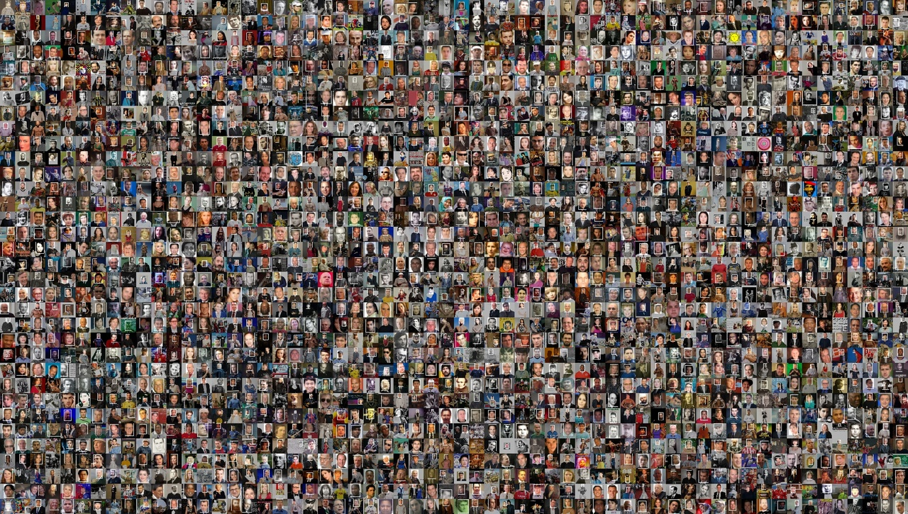
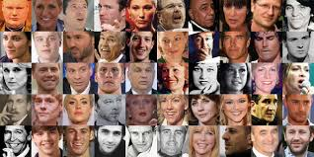
Problem Statement
Summarization Model
Corpus of Image Data
Representative Summary

Slide 6
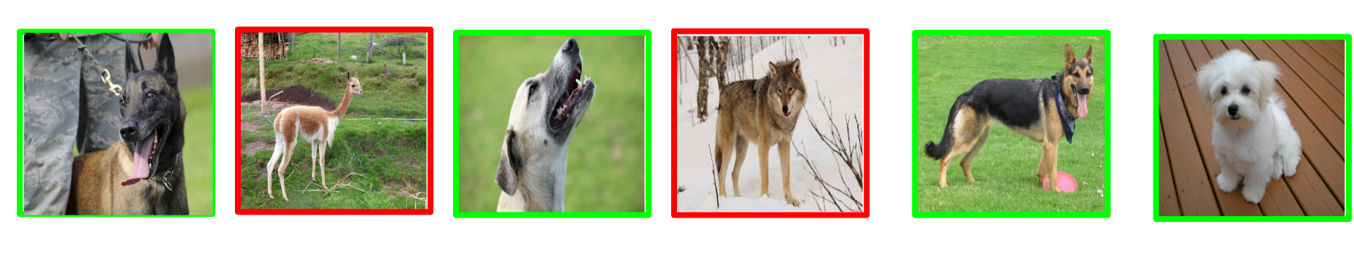
Challenges
The problem is challenging because a good summary must cover various aspects of an image set such as relevance and diversity.
Relevance in Dogs Class

Slide 7



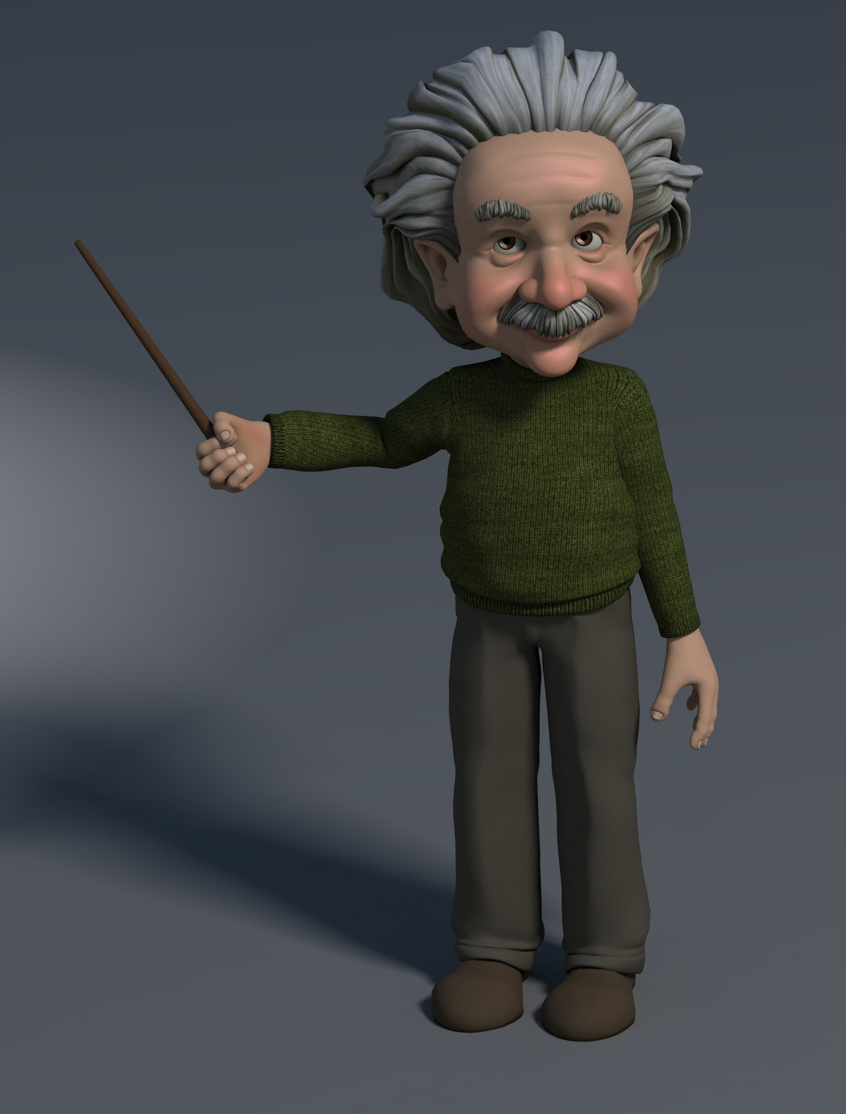


Challenges
The problem is challenging because a good summary must cover various aspects of an image set such as relevance and diversity.
Example of non-diverse set of results on Google Image search for “Professor Cartoon” Class.
All images correspond to male cartoon figure.

Slide 8
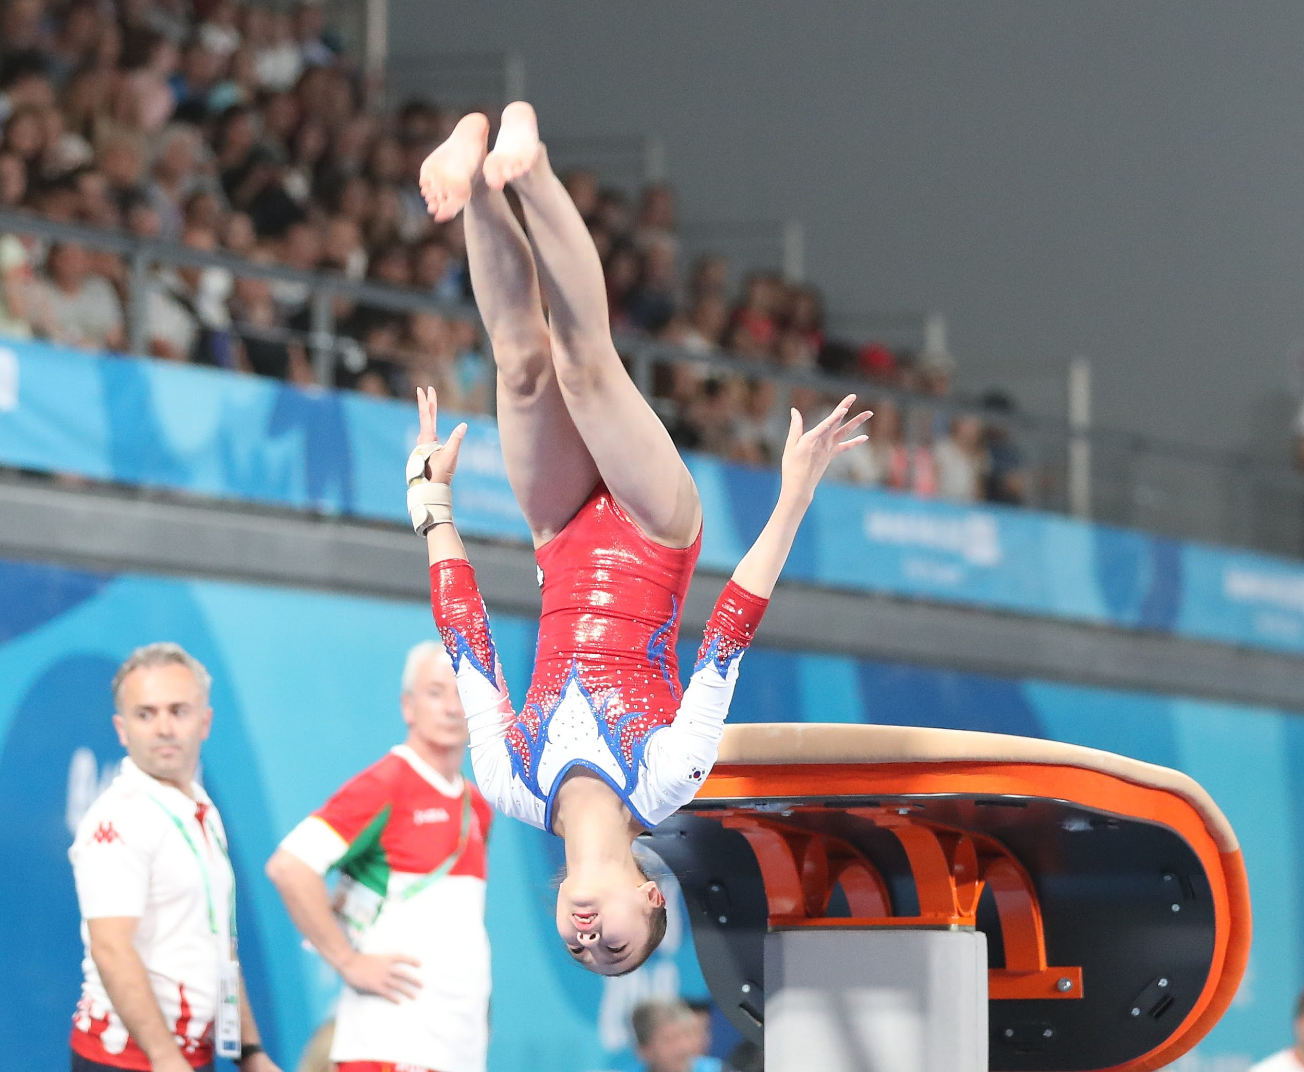
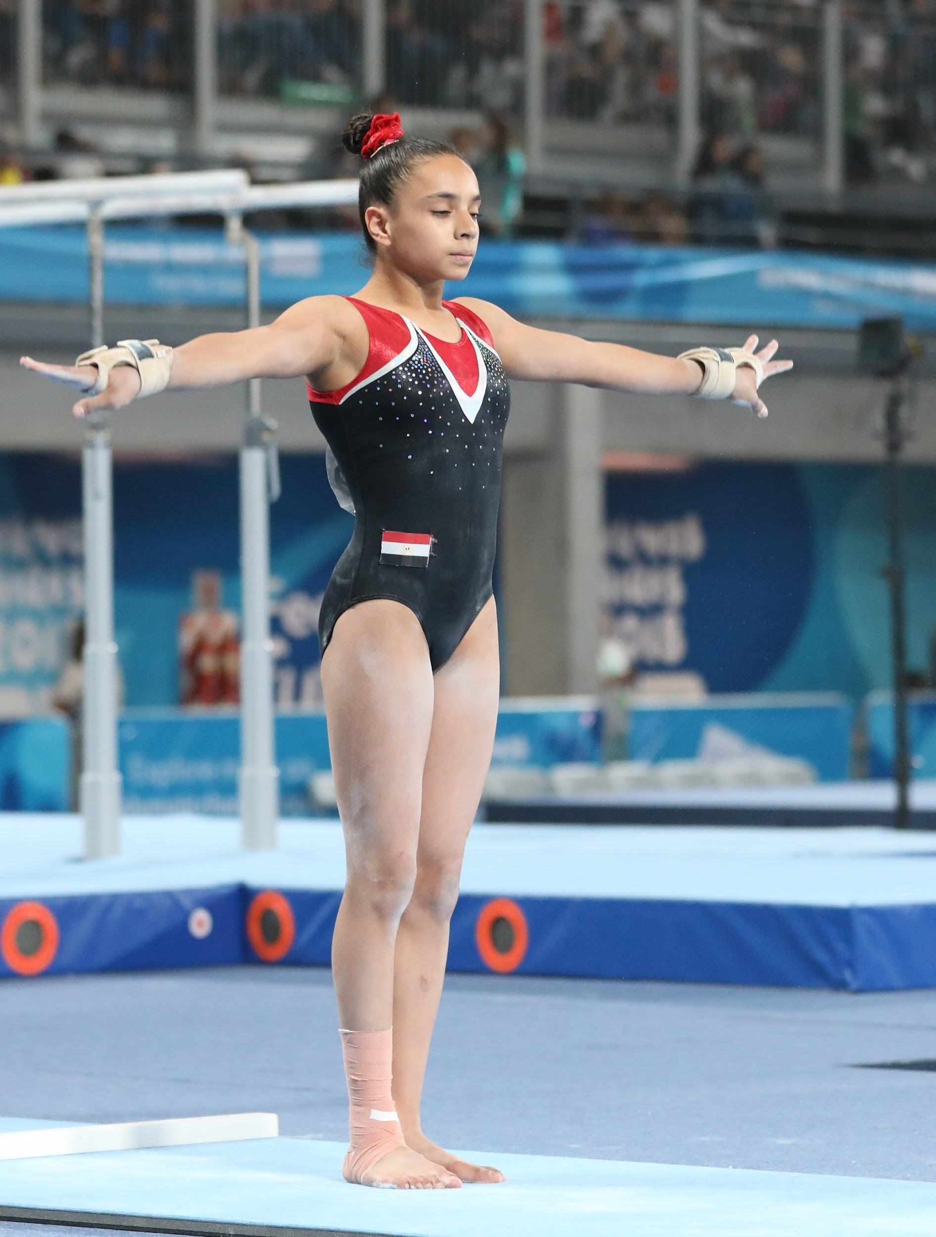
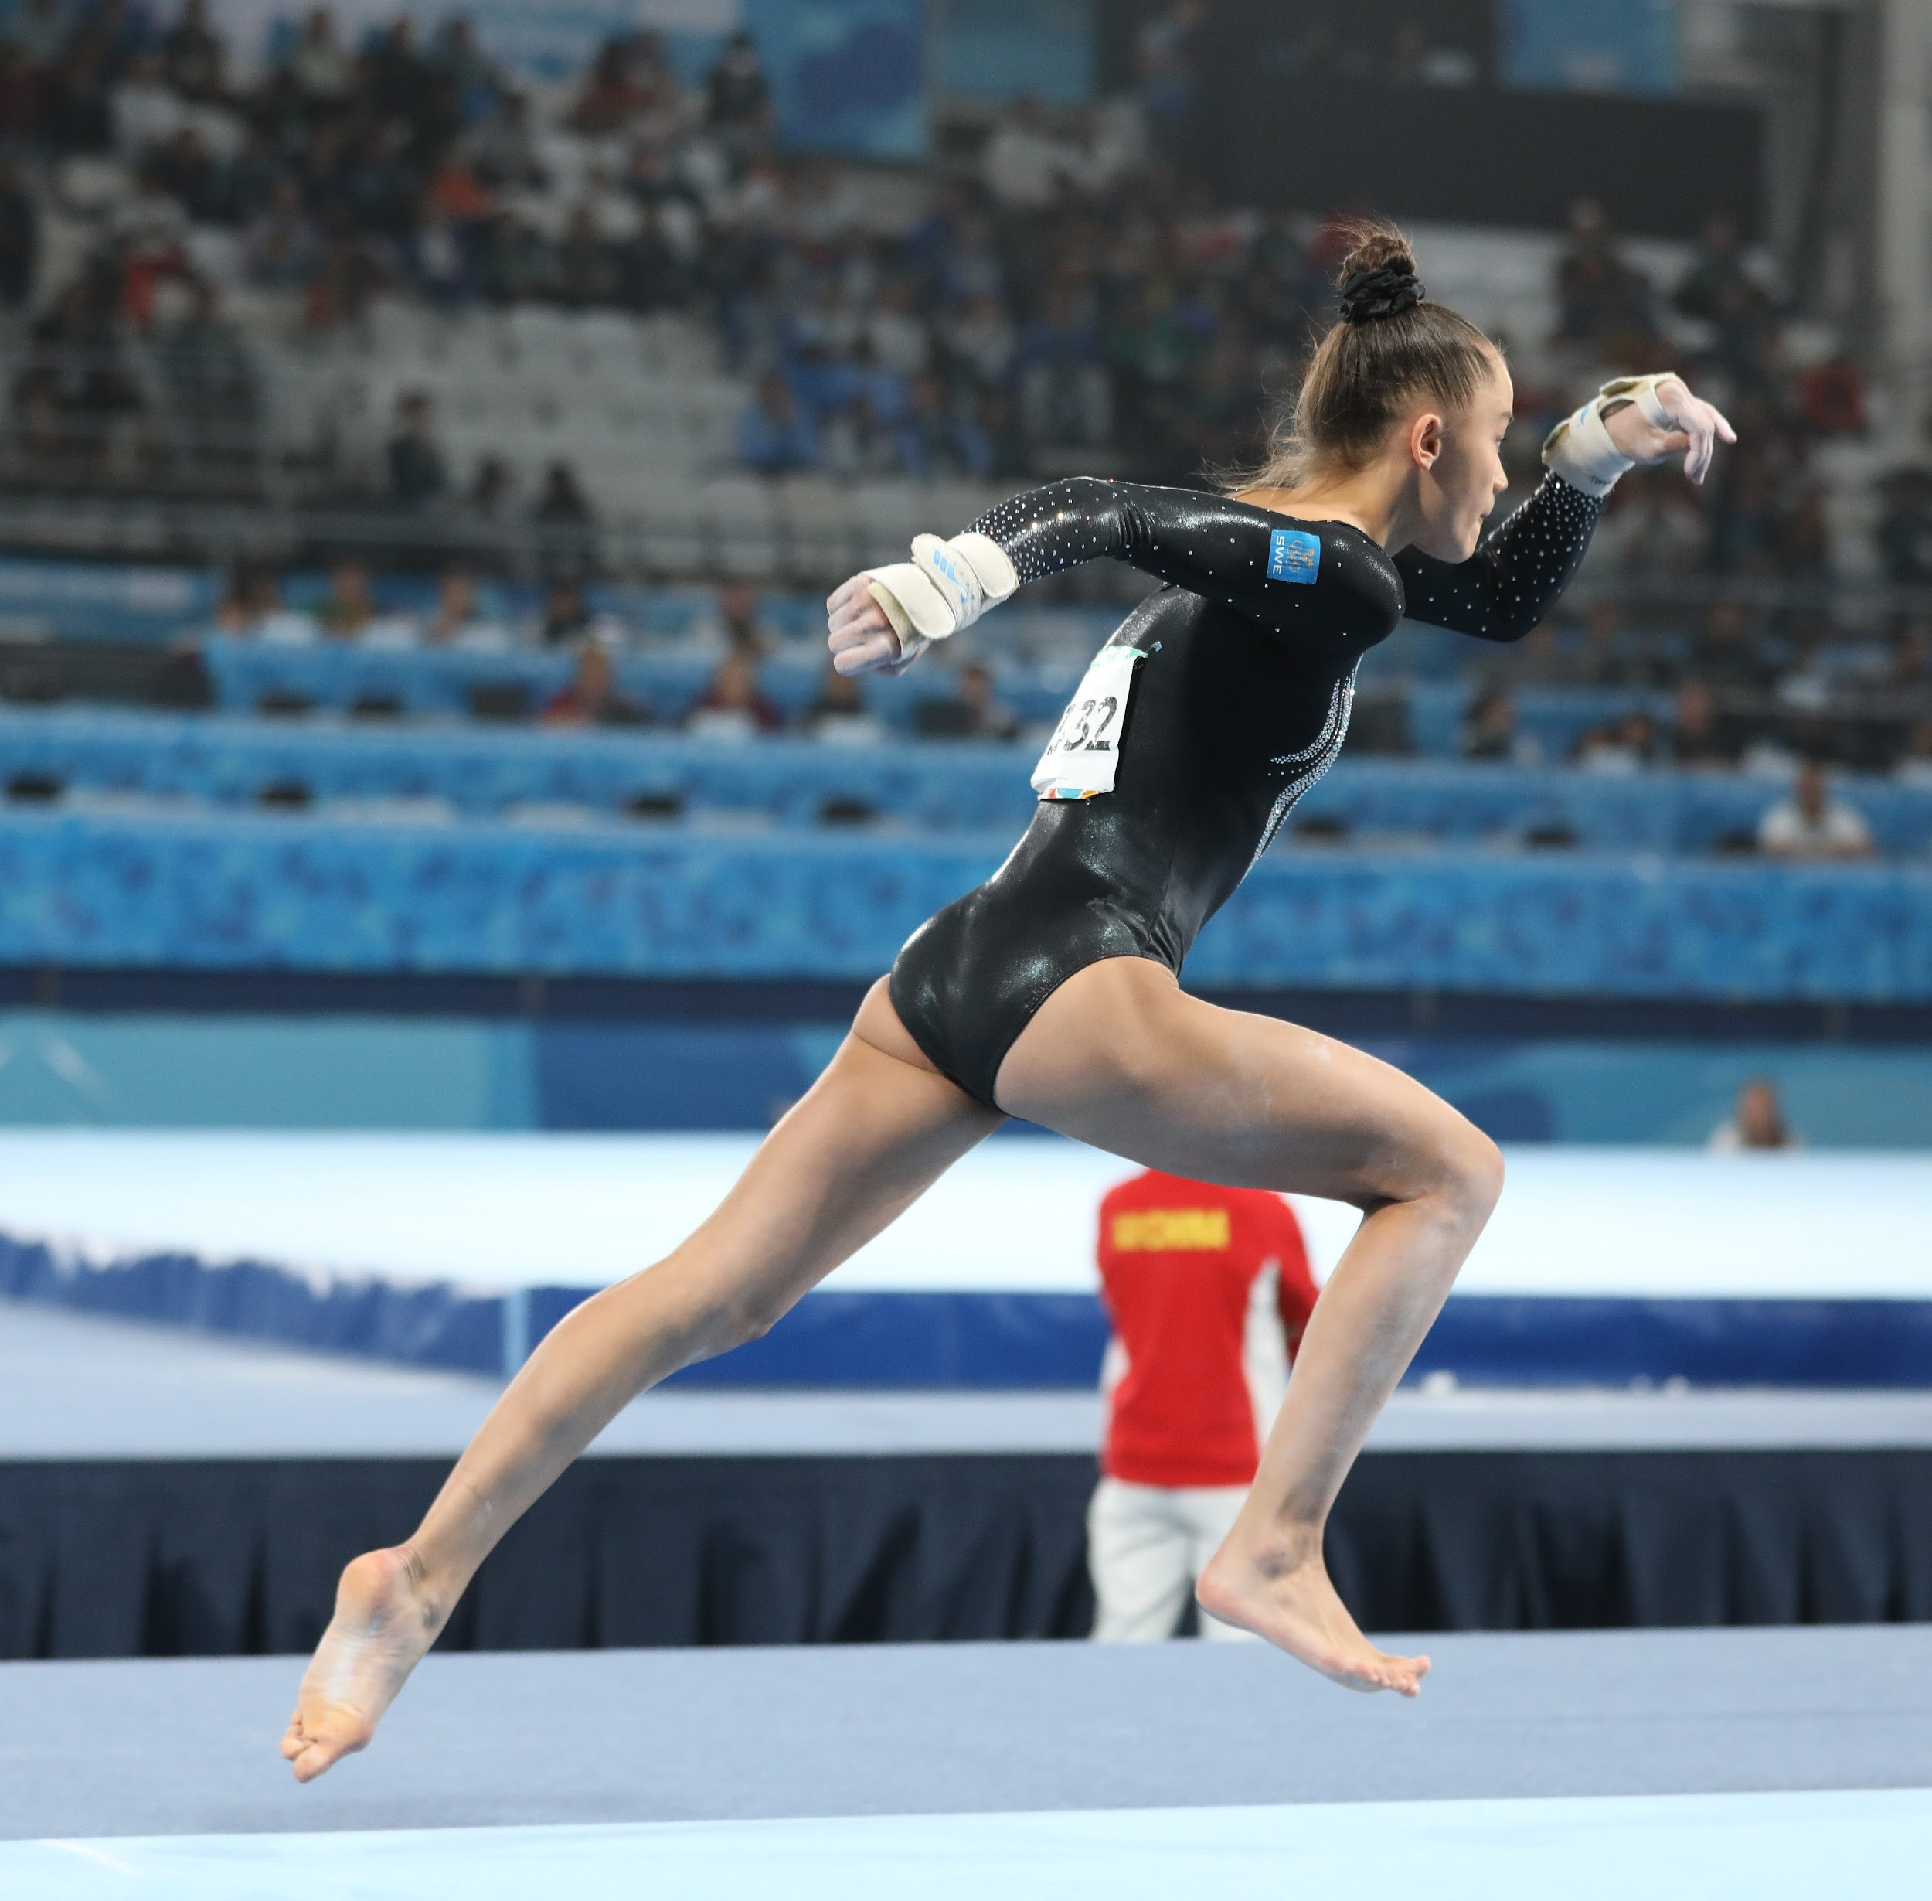
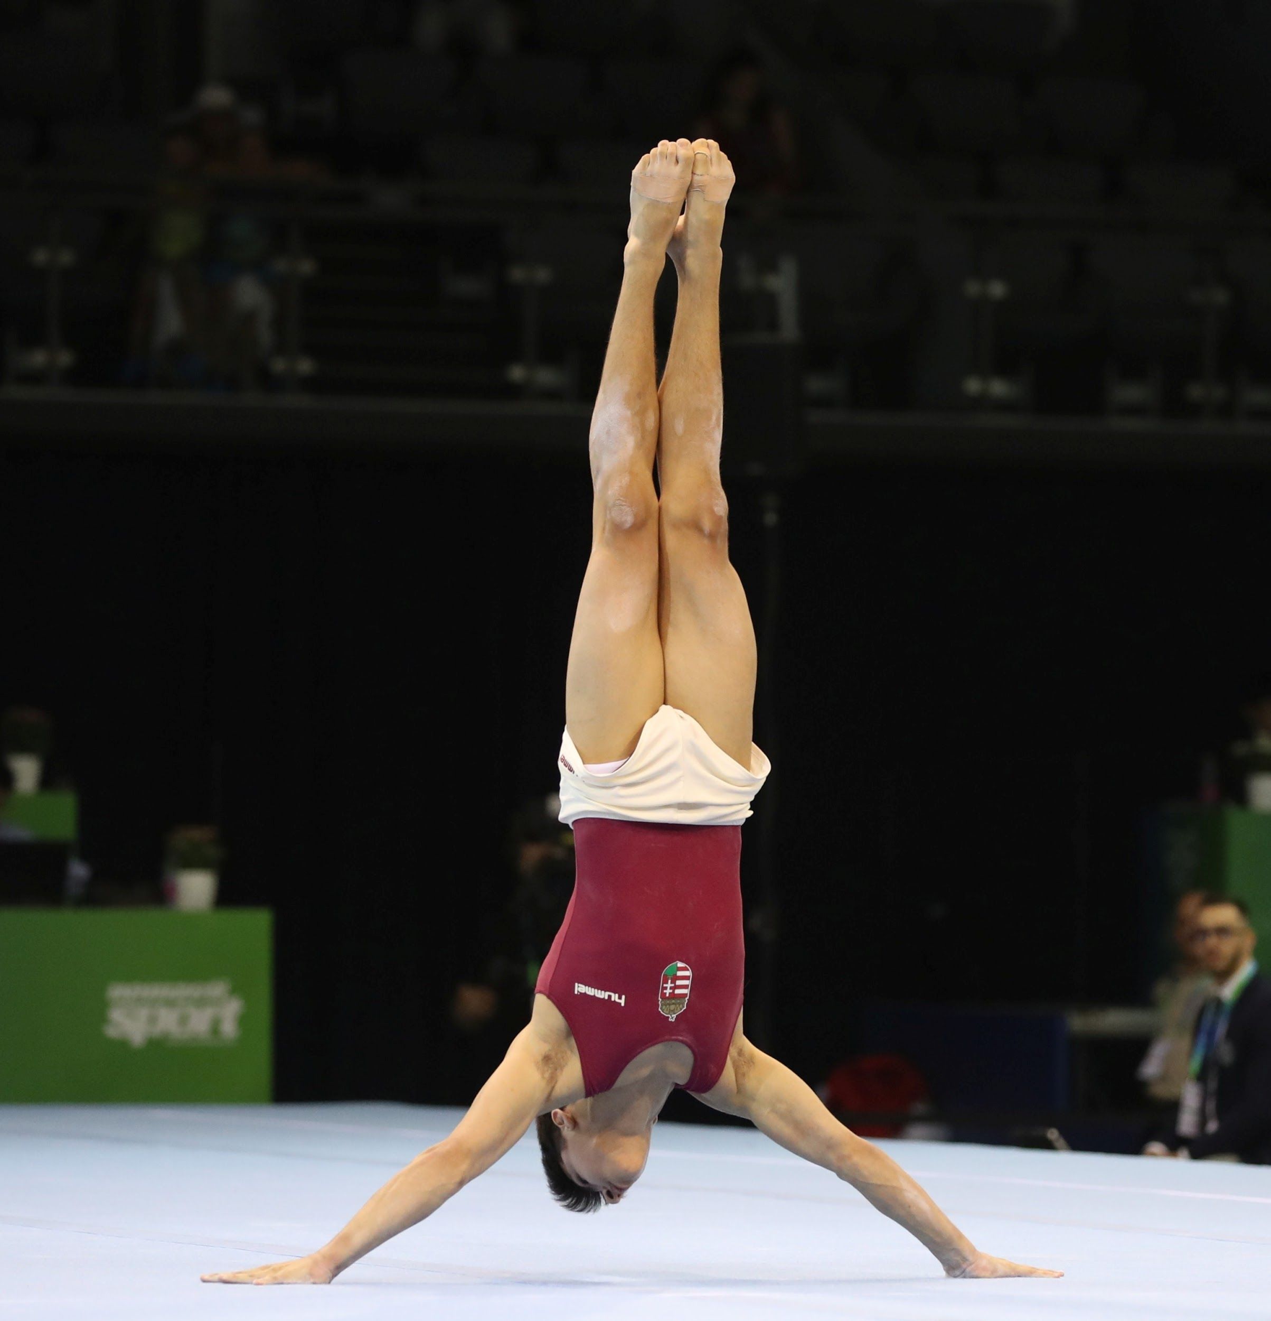
Challenges
Redundancy is very hard to find and learn in an image corpus.
There is no temporal relationship among images.
However, redundancy is present within Intra-class samples.

Slide 9
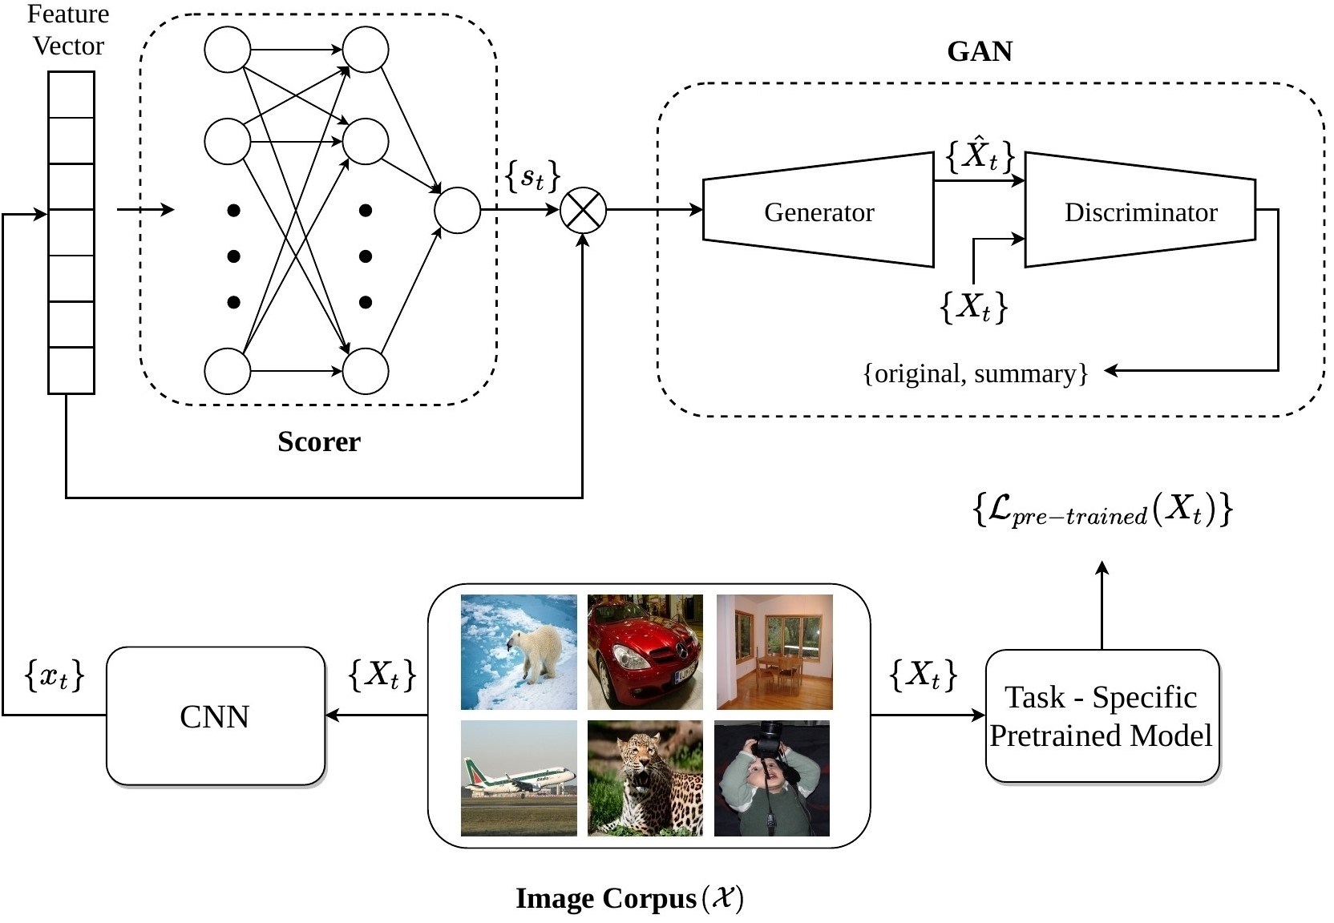
Proposed Method
2048 Dimension
Feature vectors
Images are given to a CNN from the corpus
Proposed Framework

Slide 10
Proposed Method
Scorer ANN gives score to each image in between [0,1] to define its importance in summary
Proposed Framework

Slide 11
Proposed Method
The feature vector are weighted by the scores and forwarded to generator
Proposed Framework

Slide 12
Proposed Method
The generator gives reconstruction of the image.
Discriminator tries to label images as original or from summary
Proposed Framework

Slide 13
Proposed Method
The pre-trained task specific module generates task specific loss corresponding to each image
Proposed Framework

Slide 14
Training the Model
Losses used:
Reconstruction Loss (ℒ_{reconstruct} ) is to ensure that a feature vector can be represented as a linear combination of other vectors.
Generatoror
Decoder
Summarizer
Corpus of Data
Representative
Summary
Approximation of Corpus of Data

Slide 15
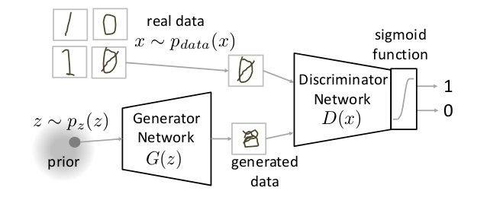
Training the Model
Losses used:
GAN Loss (ℒ_{GAN} ) is standard loss used to train the GAN in adversarial fashion.
GAN

Slide 16
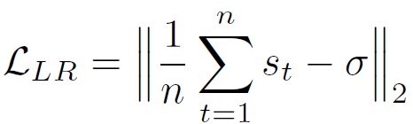
Training the Model
Losses used:
Regularization Loss (ℒ_{sparsity} ) is to regularize sparsity of the summary.
Regularization is sum of two parts Length regularizer and Detrimental Point Process (DPP) [10]
Summarizer
30% of relatively diverse images from corpus
Corpus of Data
Length Regularization (𝜎=0.3) and DPP

Slide 17
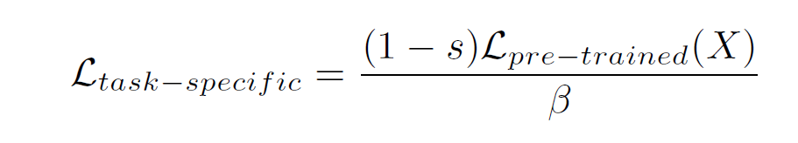
Training the Model
Losses used:
Task-Specific Loss ℒ_{taskspecific} helps incorporate knowledge of task labels in the summary.
ℒ_{taskspecific}
Summarizer
Unlabeled
Knowledge of inliers and outliers for given task
task labels
Pretrained Network
Forward Pass
Corpus of Data

Slide 18
Experimental Settings
Framework :- Tensorflow
GPU :- K40 Tesla and K20 Tesla
Hyper-parameters :- Batch Size – 50, learning rate – 0.0001, iterations 10,000
Cross validation five times
Evaluation metrics
Unsupervised: Gini Index, Task Accuracy, Reconstruction Error
Supervised: F score

Slide 19
Datasets
Statistics of the Datasets used in the work
S.No | Dataset | #Classes | #Images | Annotation
1 | CIFAR 10 | 10 | 60000 | NO
2 | CIFAR 100 | 100 | 60000 | NO
3 | AWA2 | 50 | 37322 | NO
4 | PASCAL VOC | 20 | 11530 | NO
5 | DIVERSITY 2016 | 70 | 20821 | YES

Slide 20
Experimental Results
Comparison results of Classification Accuracy with state-of-the-art at σ = 0.1
Method | CIFAR10 | CIFAR100 | AwA2
Original | 89.12 | 65.35 | 92.50
Random | 75.89 | 45.31 | 86.13
K-means | 78.24 | 48.45 | 87.35
SSDS | 79.34 | 50.60 | 88.61
HyperSphere | 79.13 | 48.32 | 88.90
Ours | 80.61 | 51.85 | 89.50

Slide 21
Experimental Results
Comparison results of F scores for variants on Diversity 2016
Method/σ | 0.01 | 0.03 | 0.05 | 0.1 | 0.3 | 0.5
Sum_{GEN} | 3.64 | 5.34 | 7.68 | 9.6 | 22.1 | 24.9
SUM_{DPP} | 4.91 | 5.76 | 9.32 | 12.6 | 21.4 | 25.6
SUM_{Task-Specific} | 5.01 | 5.34 | 7.66 | 10.7 | 21.1 | 25.6
K-means | 1.29 | 4.36 | 7.26 | 11.7 | 21.9 | 25.0

Slide 22
Experimental Results
Reconstruction Error for different values of σ
σ | Method | CIFAR10 | CIFAR100 | AwA2 | VOC
0.01 | SUMgen | 0.307 | 0.314 | 0.515 | 0.565
 | SUMdpp | 0.292 | 0.283 | 0.509 | 0.546
 | SUMtask | 0.274 | 0.268 | 0.508 | 0.542
0.03 | SUMgen | 0.286 | 0.272 | 0.412 | 0.539
 | SUMdpp | 0.252 | 0.248 | 0.416 | 0.469
 | SUMtask | 0.251 | 0.257 | 0.410 | 0.459

Slide 23
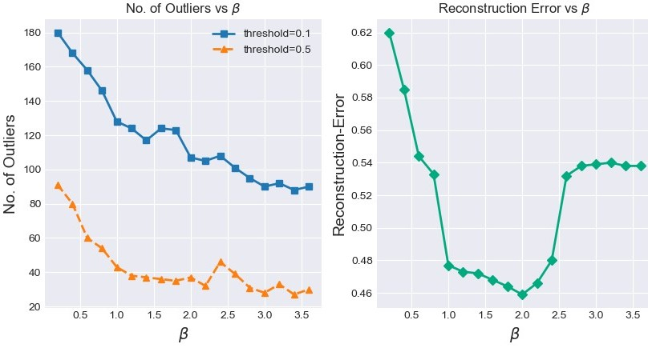
Variation of outliers to Reconstruction Error

Slide 24
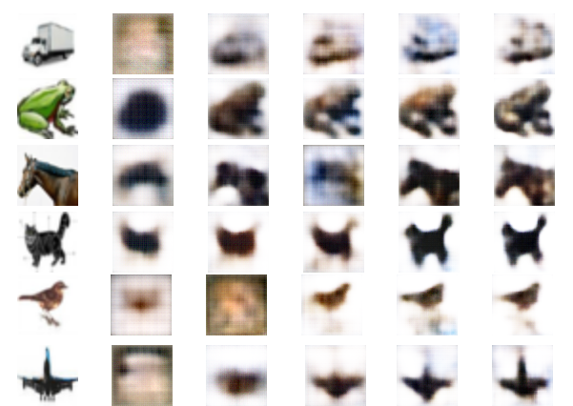
Generator Responses
GAN output for σ = 0.1
First Column – Original examples from cifar100
Every next column corresponds to the reconstruction of images at 5,10,15,20,25 epochs.

Slide 25
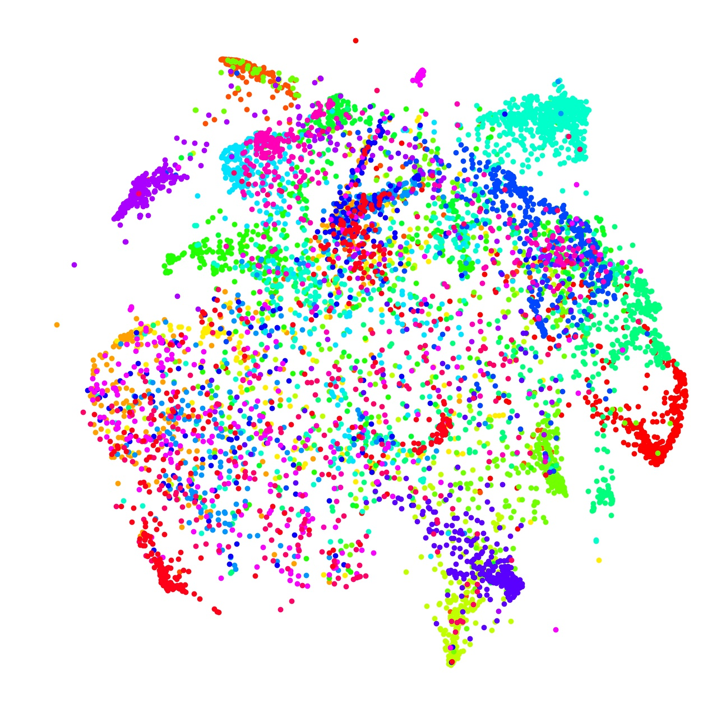
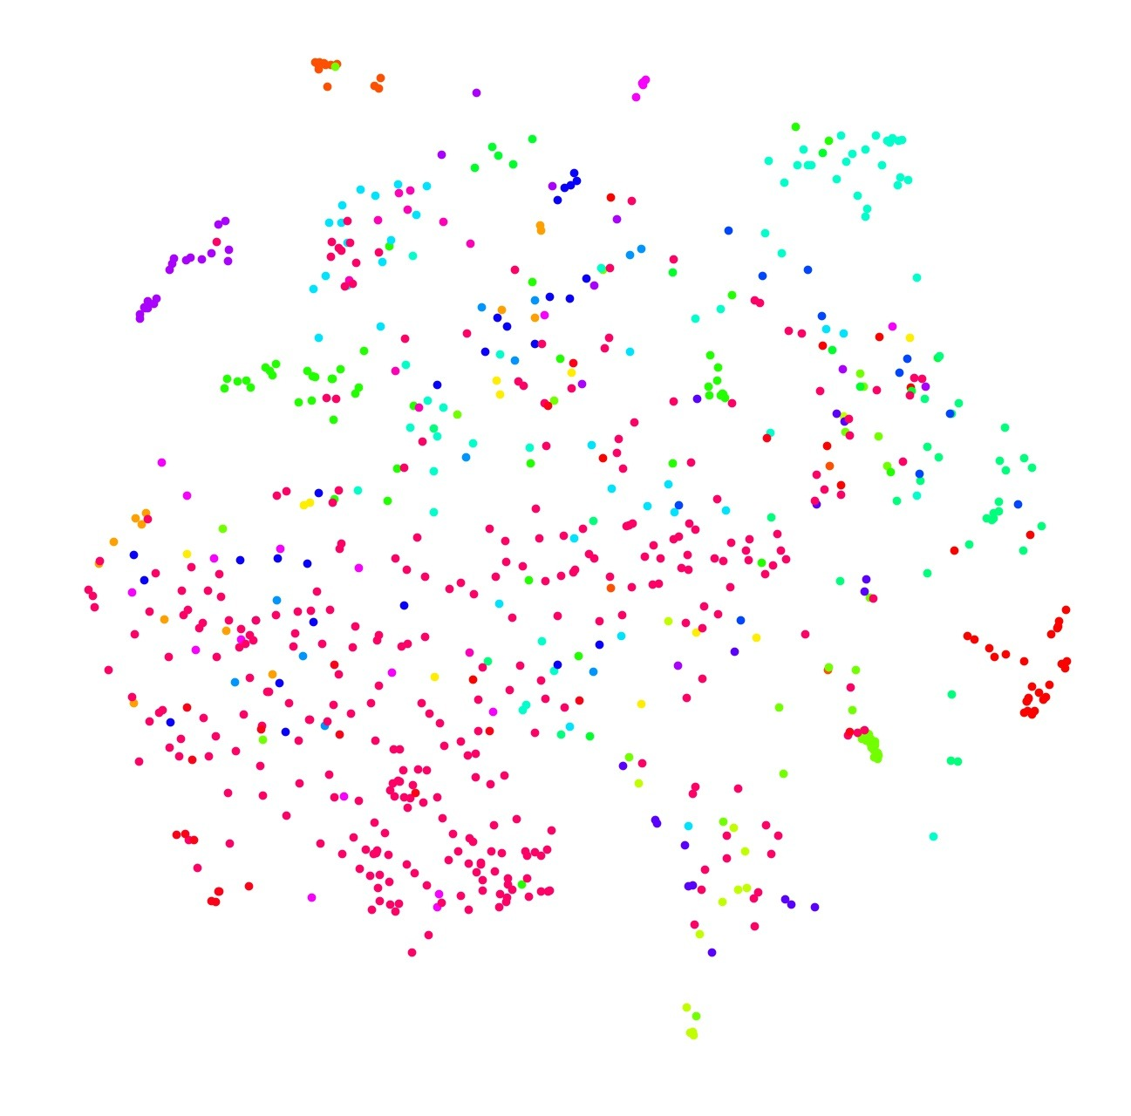
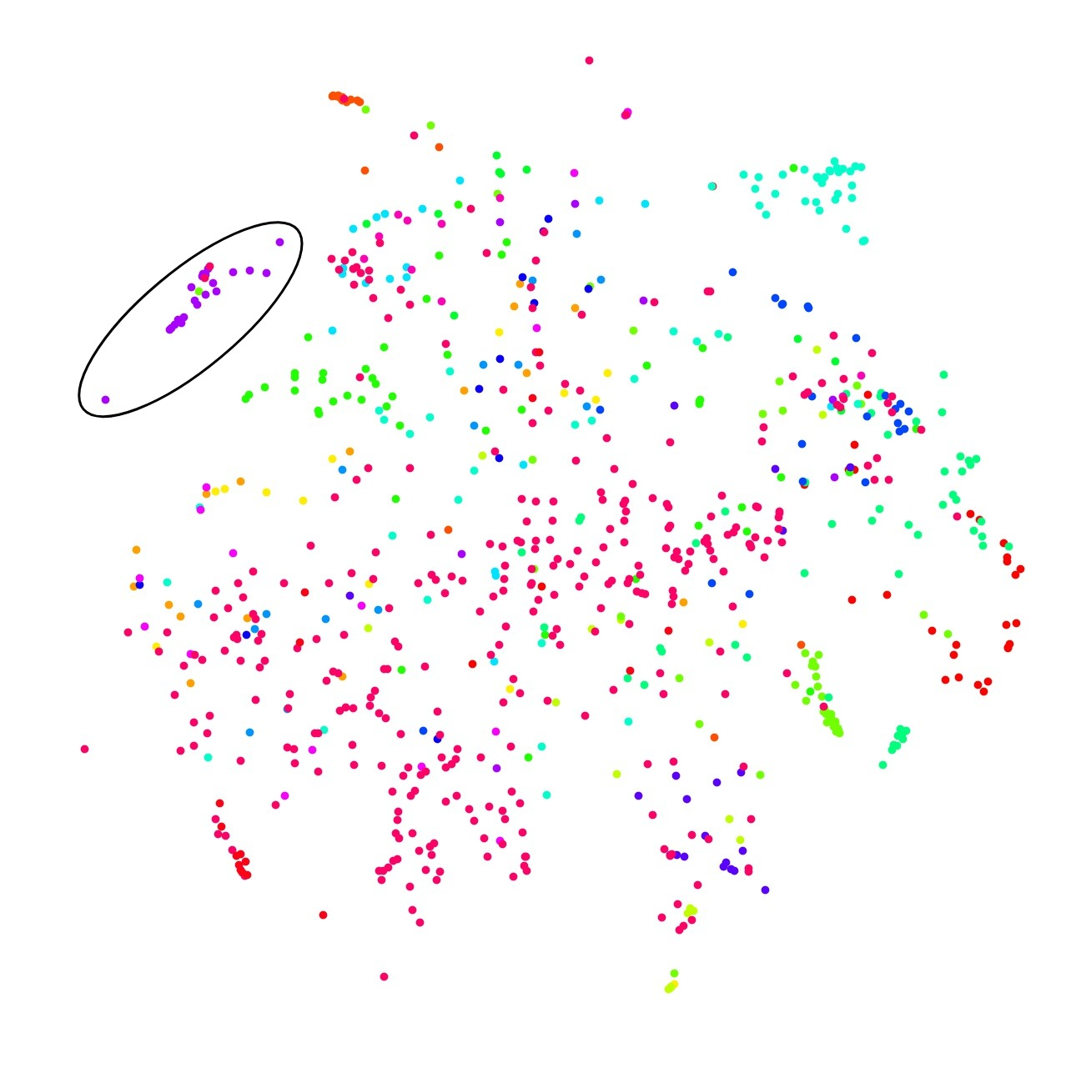
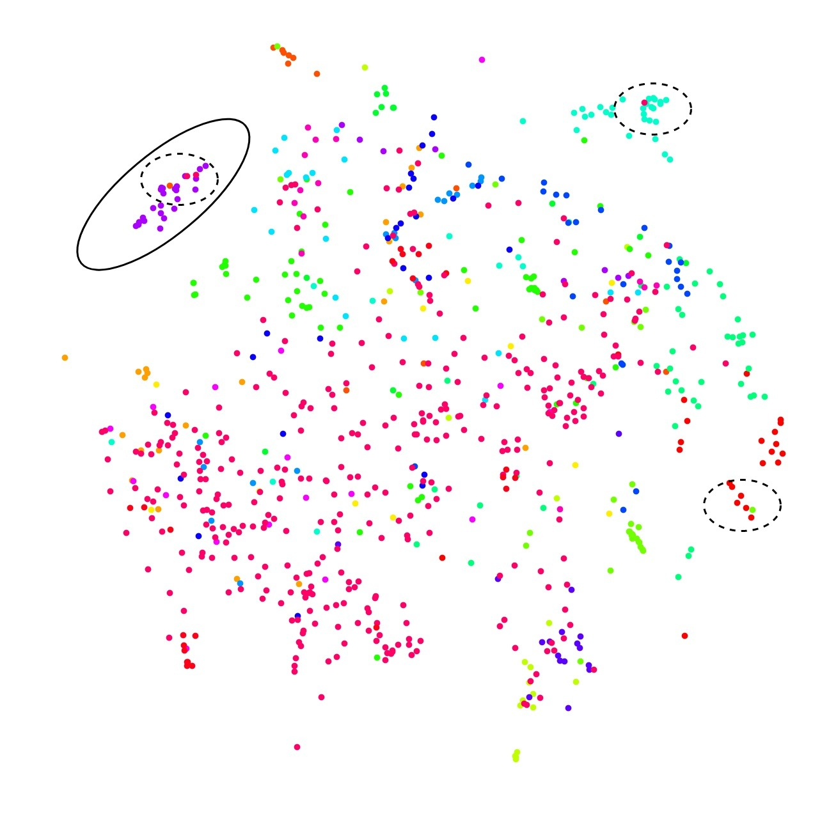
T-Sne Plots on VOC
Tsne Plot for VOC full dataset

Slide 26
T-Sne Plots on VOC
Tsne of summary at 5% of images with SUMgen

Slide 27
T-Sne Plots on VOC
Tsne of summary at 5% of images with SUMDPP

Slide 28
T-Sne Plots on VOC
Tsne of summary at 5% of images with SUMtask

Slide 29
Conclusion
We propose a novel image corpus summarization model using MLP and GAN.
Task-specific loss to generate the summary related to a given task.
The summary can be used for a quick analysis of various models without needing to train on entire dataset.
Summarization can help generate representation of large image corpuses therefore saving up on tedious annotation process.

Slide 30
Future Work Areas
Why is Correct Representation of Data Important in Real World?

Slide 31
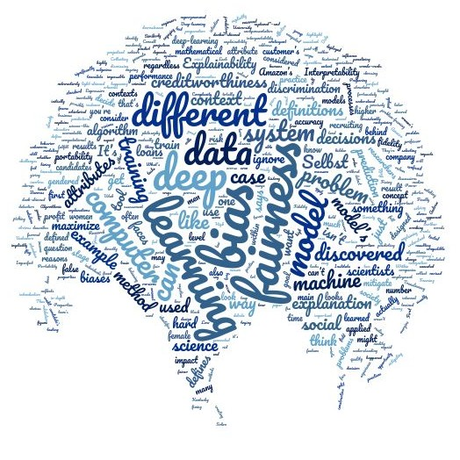
Media on AI
27% of the CEOs in the US are female.
Google images search for “CEO”, just 11% of results were female.
Gender bias and racial bias is result of fairness issues in DL systems.
Representative Summarization can help mitigate this.
Notes:
%Link this to scope of our paper%
We believe that the issue of bias in AI systems can also be mitigated to a certain extent by essentially preparing our dataset to be right representative of the original distributions such that the knowledge learnt by AI system is not based on false reasons.

Slide 32
References
Datta, Amit, Michael Carl Tschantz, and Anupam Datta. "Automated experiments on ad privacy settings." Proceedings on privacy enhancing technologies 2015.1 (2015): 92-112.
H. Wang and J. Yuan, “Representative selection on a hypersphere,” IEEE Signal Processing Letters, vol. 25,no. 11, pp. 1660–1664, 2018.
H. Wang, Y. Kawahara, C. Weng, and J. Yuan, “Representative selection with structured sparsity,” Pattern Recognition, vol. 63, pp. 268–278, 2017.
L. S. Kennedy and M. Naaman, “Generating diverse and representative image search results for landmarks,” in WWW, 2008, pp. 297–306.
S. Tschiatschek, R. K. Iyer, H. Wei, and J. A. Bilmes, “Learning mixtures of submodular functions for image collection summarization,” in NIPS, 2014, pp. 1413–1421.
H. Gu and V. Swaminathan, “From thumbnails to summaries-a single deep neural network to rule them all,” in ICME, 2018, pp. 1–6.
P. Sinha, S. Mehrotra, and R. Jain, “Summarization of personal photologs using multidimensional content and context,” in Proceedings of the 1st ACM ICMR, 2011.
B. Mahasseni, M. Lam, and S. Todorovic, “Unsupervised video summarization with adversarial lstm networks,” in Proceedings of the IEEE CVPR, 2017, pp.2982–2991.
E. Elhamifar, G. Sapiro, and S. S. Sastry, “Dissimilarity-based sparse subset selection,” IEEE TPAMI, vol. 38, no. 11, pp. 2182–2197, 2016.
I. Simon, N. Snavely, and S. M. Seitz, “Scene summarization for online image collections,” in Proceedings of the IEEE ICCV, 2007, pp. 1–8.
K. Zhang, W.-L. Chao, F. Sha, and K. Grauman, “Video summarization with long short-term memory,” in Proceedings of the ECCV, 2016.

Slide 33

THANK YOU
Email: {anurags,lakshayv}.it@nsit.net.in, subramanyam@iiitd.ac.in
Code:

